Slide 1
Chapter 3 Cybersecurity Technology
By kidane 2020

Slide 2
Access Control
Access control is the method by which systems determine whether and how to admit a user into a trusted area of the organization—that is, information systems, restricted areas such as computer rooms, and the entire physical location.
Access control is achieved by means of a combination of policies, programs, and Technologies.

Slide 3
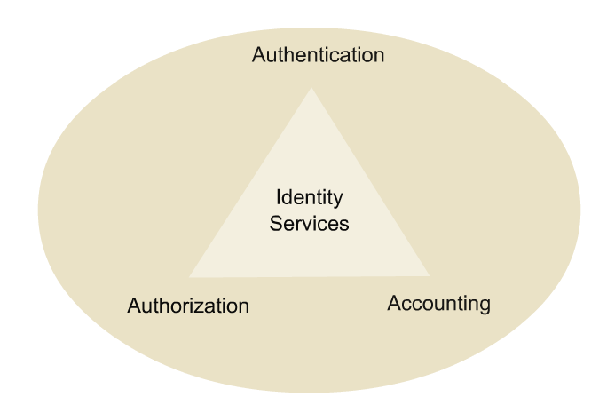
Access Control(cont.)
In general, all access control approaches rely on as the following mechanisms:
Identification
Authentication
Authorization
Accountability

Slide 4


AAA Security Services
Authentication
Who are you?
Authorization
How much can you spend?
Accounting
What did you spend it on?

Slide 5
Identification
Identification is a mechanism whereby an unverified entity—called a supplicant—that seeks access to a resource proposes a label by which they are known to the system.
The label applied to the supplicant (or supplied by the supplicant) is called an identifier (ID), and must be mapped to one and only one entity within the security domain.

Slide 6
Identification(cont.)
Some organizations use composite identifiers, concatenating elements—department codes, random numbers, or special characters—to make unique identifiers within the security domain.
Other organizations generate random IDs to protect the resources from potential attackers.
Most organizations use a single piece of unique information, such as a complete name or the user’s first initial and surname.

Slide 7
Authentication
Authentication is the process of validating a supplicant’s purported identity.
There are three widely used authentication mechanisms, or authentication factors:
Something a supplicant knows
Something a supplicant has
Something a supplicant is

Slide 8
Authentication (cont.)
Managing administrative infrastructure access is crucial.
Methods:
Password only
Local database
AAA Local Authentication (self-contained AAA)
AAA Server-based

Slide 9
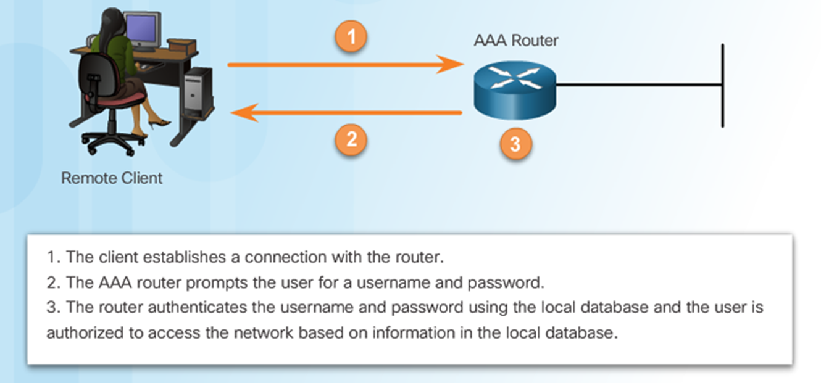
Authentication (cont.)
AAA Local Authentication

Slide 10
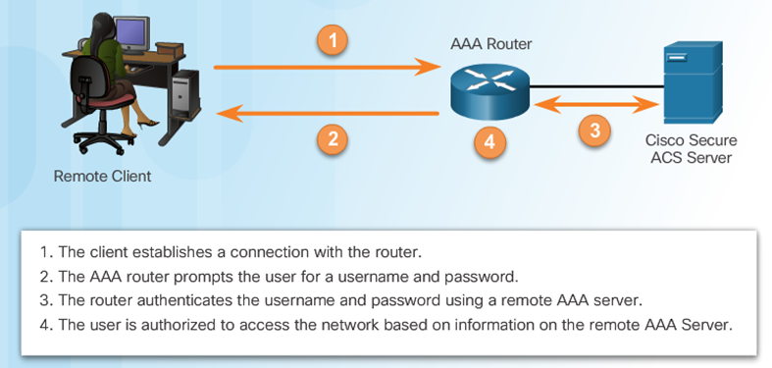
Authentication (cont.)
AAA Server based Authentication

Slide 11
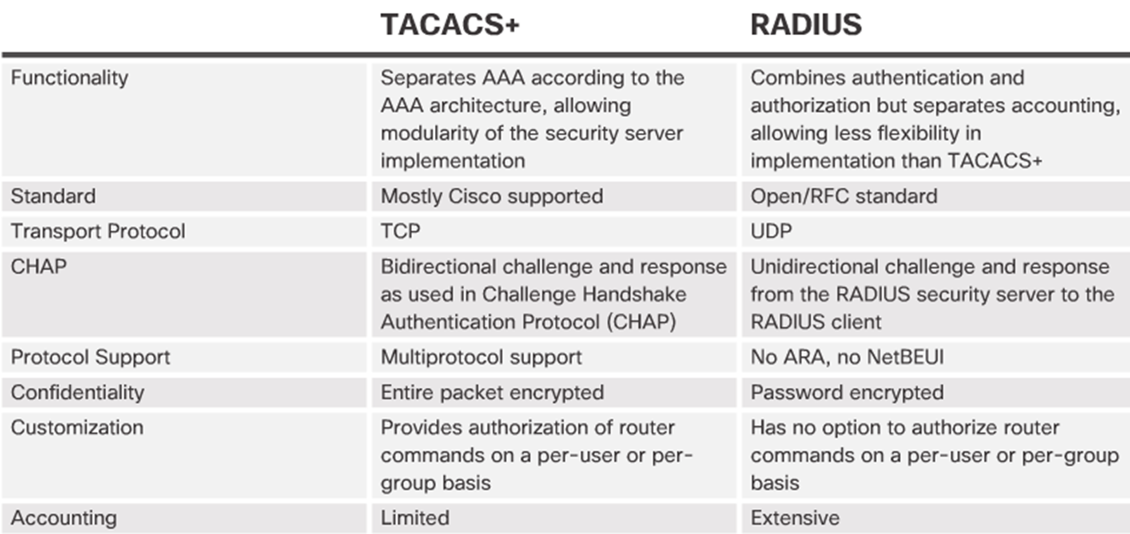
Authentication (cont.)

Slide 12
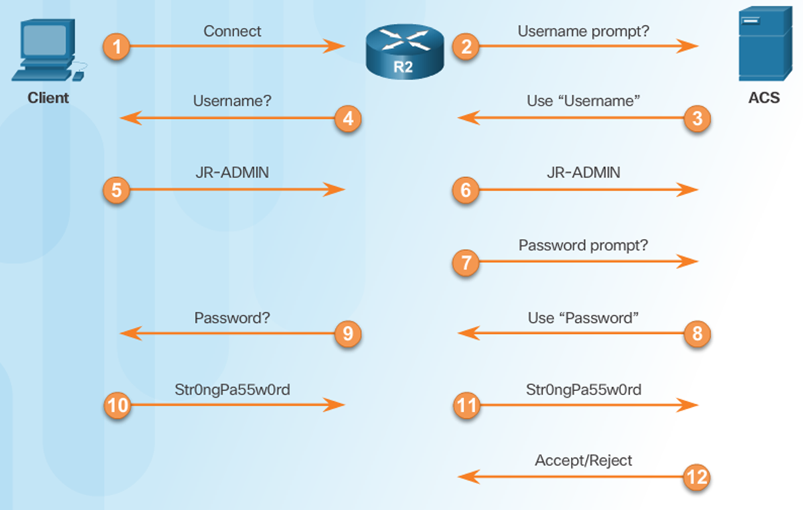
Authentication |TACACS+ Authentication Process

Slide 13
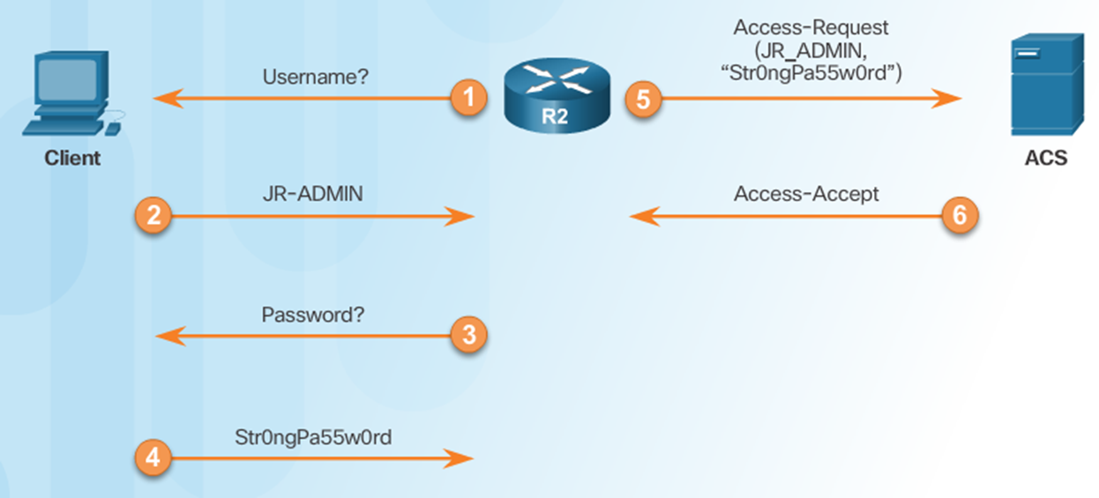
Authentication |RADIUS Authentication Process

Slide 14
Authentication (cont.)
Something a Supplicant Knows This factor of authentication relies upon what the supplicant knows and can recall—for example, a password, passphrase, or other unique authentication code, such as a personal identification number (PIN).
A password is a private word or combination of characters that only the user should know. One of the biggest debates in the information security industry concerns the complexity of passwords.
A passphrase is a series of characters, typically longer than a password, from which a virtual password is derived. For example, while a typical password might be “23skedoo,” a typical passphrase might be “MayTheForceBeWithYouAlways,” represented as “MTFBWYA.”

Slide 15
Authentication (cont.)
Something a Supplicant Has This authentication factor relies upon something a supplicant has and can produce when necessary.
One example is dumb cards, such as ID cards or ATM cards with magnetic stripes containing the digital (and often encrypted) user PIN, against which the number a user input is compared.
The smart card contains a computer chip that can verify and validate a number of pieces of information instead of just a PIN.

Slide 16
Authentication (cont.)
Something a Supplicant Is or Can Produce This authentication factor relies upon individual characteristics, such as
fingerprints, palm prints, hand topography, hand geometry, or retina and iris scans, or something a supplicant can produce on demand, such as voice patterns, signatures, or keyboard kinetic measurements.
Some of these characteristics, known collectively as biometrics.

Slide 17
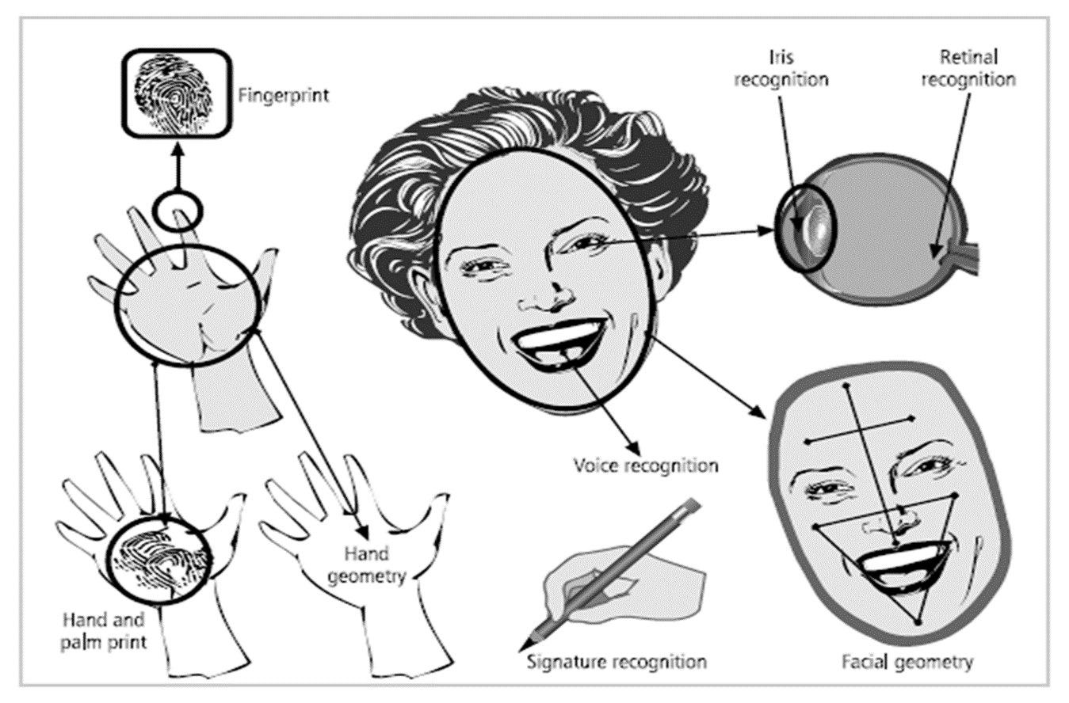
Authentication (cont.)

Slide 18
Authorization
Authorization is the matching of an authenticated entity to a list of information assets and corresponding access levels. This list is usually an ACL or access control matrix. In general, authorization can be handled in one of three ways:
Authorization for each authenticated user, in which the system performs an authentication process to verify each entity and then grants access to resources for only that entity. This quickly becomes a complex and resource-intensive process in a computer system.
Authorization for members of a group, in which the system matches authenticated entities to a list of group memberships, and then grants access to resources based on the group’s access rights. This is the most common authorization method.

Slide 19
Authorization(cont.)
Authorization across multiple systems, in which a central authentication and authorization system verifies entity identity and grants it a set of credentials.
Authorization credentials (sometimes called authorization tickets) are issued by an authenticator and are honored by many or all systems within the authentication domain.
Sometimes called single sign-on (SSO) or reduced sign-on, authorization credentials are becoming more common and are frequently enabled using a shared directory structure such as the Lightweight Directory Access Protocol (LDAP).

Slide 20
Authorization(cont.)
Provides the method for remote or local access control
Including one-time authorization or authorization for each service, per-user account list and profile, user group support
Once a user has authenticated, authorization services determine which:
Resources the user can access.
Operations the user is allowed to perform.
E.g., “User ‘student’ can access host server XYZ using Telnet only.”
As with authentication, AAA authorization is configured by defining a “named” list of authorization methods, and then applying that list to various interfaces.

Slide 21

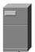

Authorization(cont.)
#
AAA Router
Secure Server
Remote Client
1
2
3
User has authenticated and a session has been established to the AAA server.
When the user attempts to enter privileged EXEC mode command, the router requests authorization from a AAA server to verify that the user has the right to use it.
The AAA server returns a “PASS/FAIL” response.

Slide 22
Server-Based AAA Authorization
Authentication vs. Authorization
Authentication ensures a device or end-user is legitimate
Authorization allows or disallows authenticated users access to certain areas and programs on the network.
TACACS+ vs. RADIUS
TACACS+ separates authentication from authorization
RADIUS does not separate authentication from authorization

Slide 23
Accounting
Provides the method for collecting and sending security server information.
Used for billing, auditing, and reporting, such as user identities, start and stop times, executed commands, number of packets / bytes, …
With AAA accounting activated, the router reports user activity to the TACACS+ security server in the form of accounting records.
Accounting is configured by defining a “named” list of accounting methods, and then applying that list to various interfaces.

Slide 24
Accounting(cont.)
#
Secure Server
Remote Client
AAA Router
1
2
When a user has been authenticated, the AAA accounting process generates a start message to begin the accounting process.
When the user logs out, a stop message is recorded and the accounting process ends.

Slide 25
Accountability (cont.)
Accountability, also known as auditability, ensures that all actions on a system—authorized or unauthorized—can be attributed to an authenticated identity.
Accountability is most often accomplished by means of system logs and database journals, and the auditing of these records.
Systems logs record specific information, such as failed access attempts and systems modifications. Logs have many uses, such as intrusion detection, determining the root cause of a system failure, or simply tracking the use of a particular resource.

Slide 26
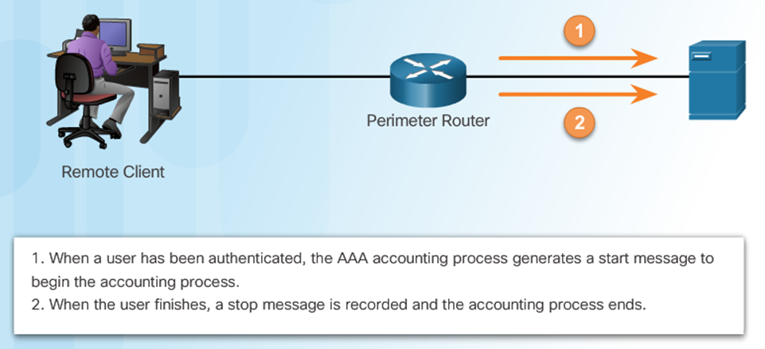
Accounting (cont.)

Slide 27
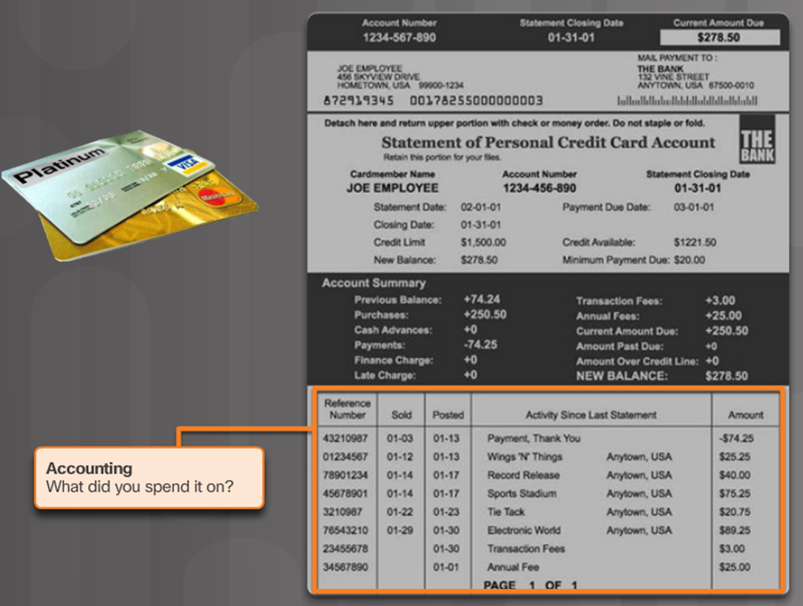
Server Based AAA Accounting

Slide 28
AAA Benefits
Increased flexibility and control of access configuration
Scalability
Multiple backup systems
Standardized authentication methods
RADIUS, TACACS+ and Kerberos

Slide 29
AAA Scalability
AAA is typically implemented using a dedicated ACS server to store usernames / passwords in a centralized database.
Information is centrally entered / updated unlike a local database which must be configured on every router.

Slide 30
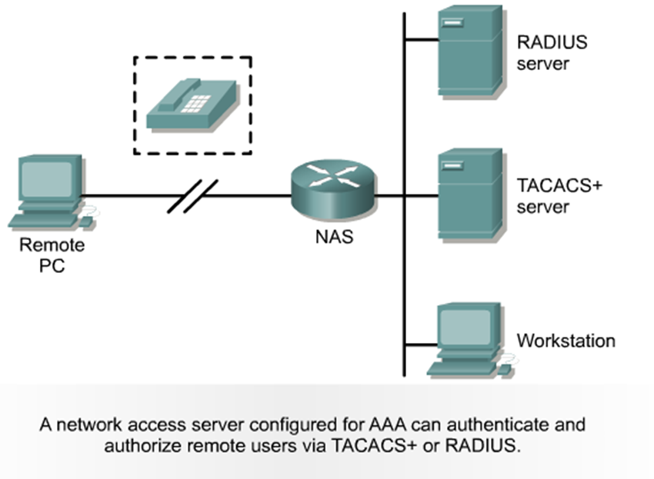
AAA – Multiple backup systems
Fault Tolerance can be configured in a fallback sequence.
Consult a security server…
Local Database
Etc.

Slide 31
AAA – Standardized Security Protocols
AAA supports standardized security protocols.
TACACS+
Terminal Access Controller Access Control System Plus
Replaces legacy protocols TACACS and XTACACS
RADIUS
Remote Authentication Dial-In User Service

Slide 32
AAA – Standardized Security Protocols (Cont.)
Both protocols can be used to communicate between client and AAA servers.
TACACS+ is considered the more secure protocol because all exchanges are encrypted.
Radius only encrypts the user password.
It does not encrypt user names, accounting information, or any other information carried in the radius message.

Slide 33
Firewalls
A firewall in an information security program is similar to a building’s firewall in that it prevents specific types of information from moving between the outside world, known as the untrusted network (for example, the Internet), and the inside world, known as the trusted network.
The firewall may be a separate computer system, a software service running on an existing router or server, or a separate network containing a number of supporting devices.

Slide 34
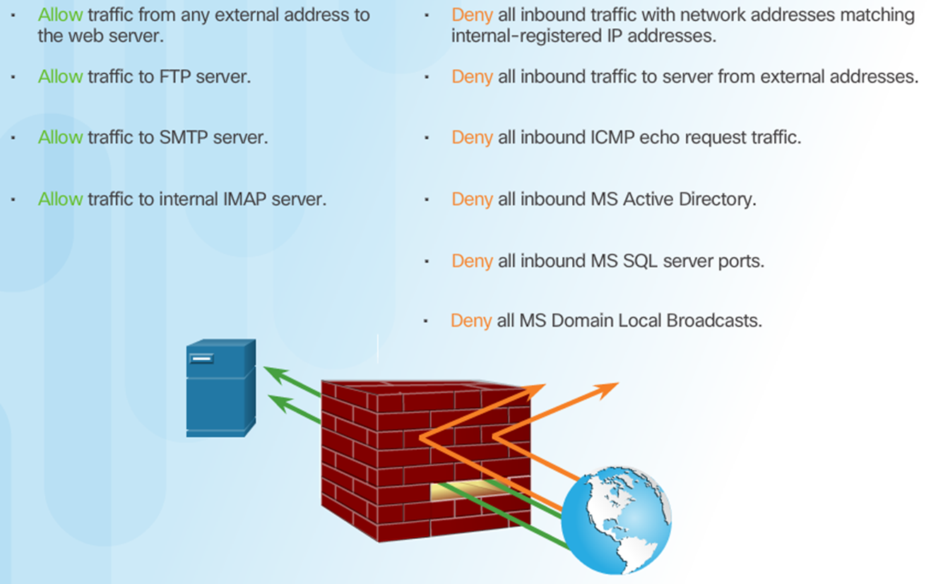
Firewall (cont.)

Slide 35
Firewall(cont.)
Firewalls can be categorized by processing mode, development era, or structure.
Firewalls fall into five major processing-mode categories:
packet-filtering firewalls,
application gateways,
circuit gateways,
MAC layer firewalls, and
hybrids.
Hybrid firewalls use a combination of the other four modes, and in practice, most firewalls fall into this category, since most firewall implementations use multiple approaches.

Slide 36
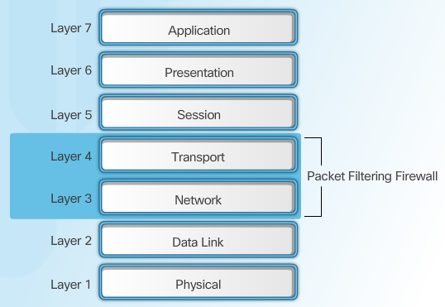
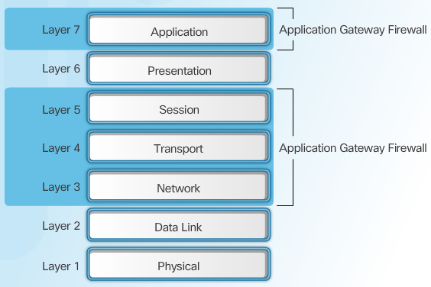
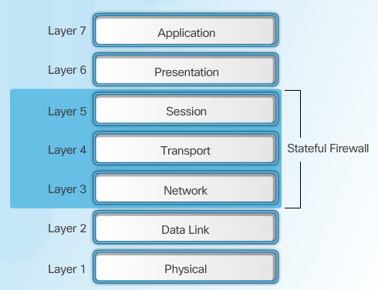
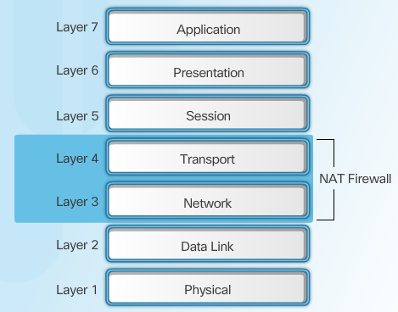
Firewall Type Descriptions
Packet Filtering Firewall
Application Gateway Firewall
Stateful Firewall
NAT Firewall
Notes:
4.2.2.1 Firewall Type Descriptions

Slide 37
Packet-filtering firewall
The packet-filtering firewall, also simply called a filtering firewall, examines the header information of data packets that come into a network.
A packet-filtering firewall installed on a TCP/IP- based network typically functions at the IP level and determines whether to drop a packet (deny) or forward it to the next network connection (allow) based on the rules programmed into the firewall.
Packet-filtering firewalls examine every incoming packet header and can selectively filter packets based on header information such as destination address, source address, packet type, and other key information.

Slide 38
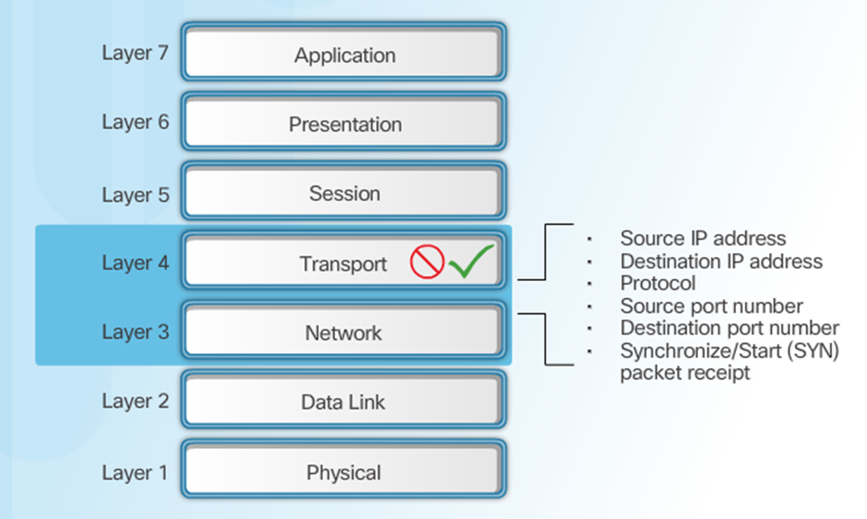
Packet-filtering firewall (Cont.)

Slide 39
Packet-filtering firewall (Cont.)
Filtering firewalls inspect packets at the network layer, or Layer 3, of the Open Systems Interconnect (OSI) model, which represents the seven layers of networking processes.
If the device finds a packet that matches a restriction, it stops the packet from traveling from one network to another. The restrictions most commonly implemented in packet-filtering firewalls are based on a combination of the following:
IP source and destination address
Direction (inbound or outbound)
Protocol (for firewalls capable of examining the IP protocol layer)
Transmission Control Protocol (TCP) or User Datagram Protocol (UDP) source and
Destination port requests (for firewalls capable of examining the TCP/UPD layer)

Slide 40
Packet-filtering firewall (Cont.)
Simple firewall models examine two aspects of the packet header: the destination and source address.
They enforce address restrictions, rules designed to prohibit packets with certain addresses or partial addresses from passing through the device.
They accomplish this through ACLs, which are created and modified by the firewall administrators.

Slide 41
Packet-filtering firewall (Cont.)
The ability to restrict a specific service is now considered standard in most routers and is invisible to the user.
Unfortunately, such systems are unable to detect whether packet headers have been modified, an advanced technique used in some attacks, including IP spoofing attacks.
There are three subsets of packet-filtering firewalls:
static filtering
dynamic filtering
stateful inspection.

Slide 42
Packet-filtering firewall |Static Firewall
Static filtering requires that the filtering rules be developed and installed with the firewall.
The rules are created and sequenced either by a person directly editing the rule set, or by a person using a programmable interface to specify the rules and the sequence.
Any changes to the rules require human intervention. This type of filtering is common in network routers and gateways.

Slide 43
Packet-filtering firewall |Dynamic Firewall
A dynamic filtering firewall can react to an emergent event and update or create rules to deal with that event.
This reaction could be positive, as in allowing an internal user to engage in a specific activity upon request, or negative, as in dropping all packets from a particular address when an increase in the presence of a particular type of malformed packet is detected.
While static filtering firewalls allow entire sets of one type of packet to enter in response to authorized requests, the dynamic packet-filtering firewall allows only a particular packet with a particular source, destination, and port address to enter.

Slide 44
Packet-filtering firewall |Stateful Firewall
State-full inspection firewalls, also called stateful firewalls, keep track of each network connection between internal and external systems using a state table.
A state table tracks the state and context of each packet in the conversation by recording which station sent what packet and when. Like first generation firewalls, stateful inspection firewalls perform packet filtering, but they take it a step further.
Whereas simple packet-filtering firewalls only allow or deny certain packets based on their address, a stateful firewall can expedite incoming packets that are responses to internal requests. If the stateful firewall receives an incoming packet that it cannot match in its state table, it refers to its ACL to determine whether to allow the packet to pass.

Slide 45
Packet-filtering firewall |Stateful Firewall (cont.)
The primary disadvantage of this type of firewall is the additional processing required to manage and verify packets against the state table.
This can leave the system vulnerable to a DoS or DDoS attack. In such an attack, the system receives a large number of external packets, which slows the firewall because it attempts to compare all of the incoming packets first to the state table and then to the ACL.
On the positive side, these firewalls can track connectionless packet traffic, such as UDP and remote procedure calls (RPC) traffic.

Slide 46
Packet-filtering firewall |Stateful Firewall (cont.)
Dynamic state-full filtering firewalls keep a dynamic state table to make changes (within predefined limits) to the filtering rules based on events as they happen.
A state table looks similar to a firewall rule set but has additional information, as shown in following Table.
The state table contains the familiar source IP and port, and destination IP and port, but adds information on the protocol used (i.e., UDP or TCP), total time in seconds, and time remaining in seconds.
Many state table implementations allow a connection to remain in place for up to 60 minutes without any activity before the state entry is deleted.

Slide 47
Application Gateways
Application Gateways The application gateway, also known as an application-level firewall or application firewall, is frequently installed on a dedicated computer, separate from the filtering router, but is commonly used in conjunction with a filtering router.
The application firewall is also known as a proxy server since it runs special software that acts as a proxy for a service request.

Slide 48
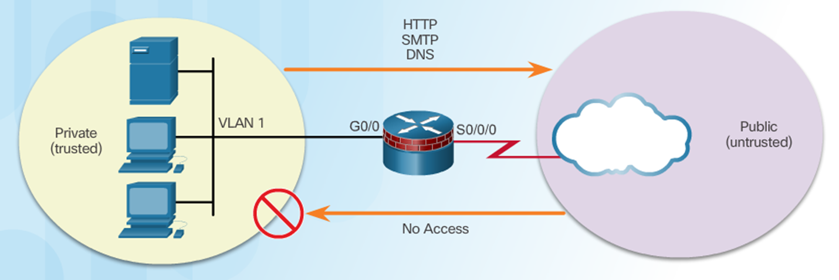
Application Gateways (Cont.)
Inside and Outside Networks

Slide 49
Application Gateways (Cont.)
For example, an organization that runs a Web server can avoid exposing the server to direct user traffic by installing a proxy server configured with the registered domain’s URL.
This proxy server receives requests for Web pages, accesses the Web server on behalf of the external client, and returns the requested pages to the users.
These servers can store the most recently accessed pages in their internal cache, and are thus also called cache servers. The benefits from this type of implementation are significant.

Slide 50
Application Gateways (Cont.)
For one, the proxy server is placed in an unsecured area of the network or in the demilitarized zone (DMZ)—an intermediate area between a trusted network and an untrusted network—so that it, rather than the Web server, is exposed to the higher levels of risk from the less trusted networks.
Additional filtering routers can be implemented behind the proxy server, limiting access to the more secure internal system, and thereby further protecting internal systems.

Slide 51
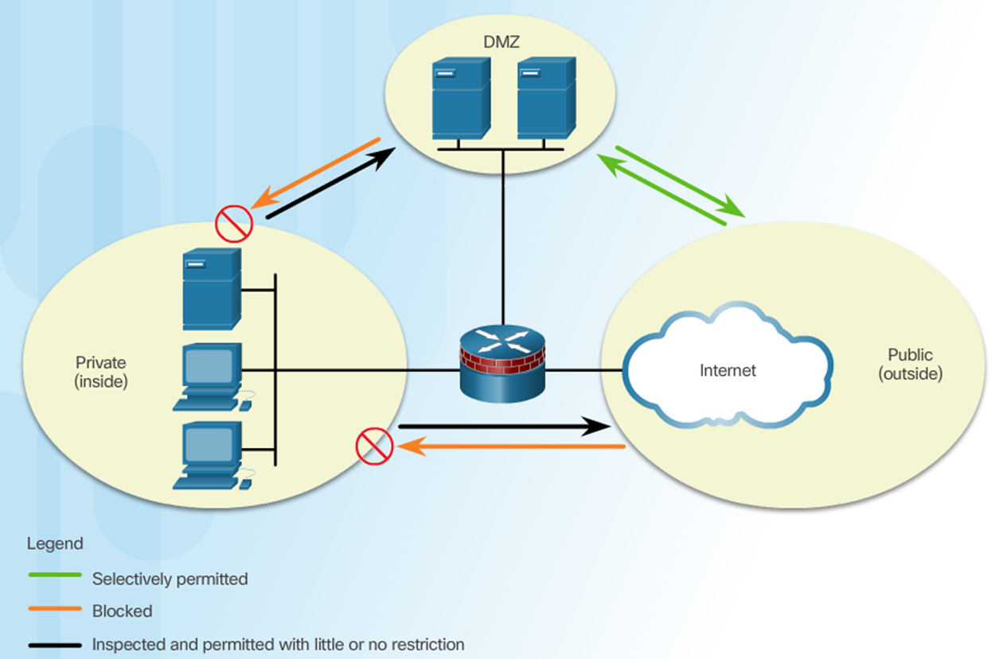
Cont.

Slide 52
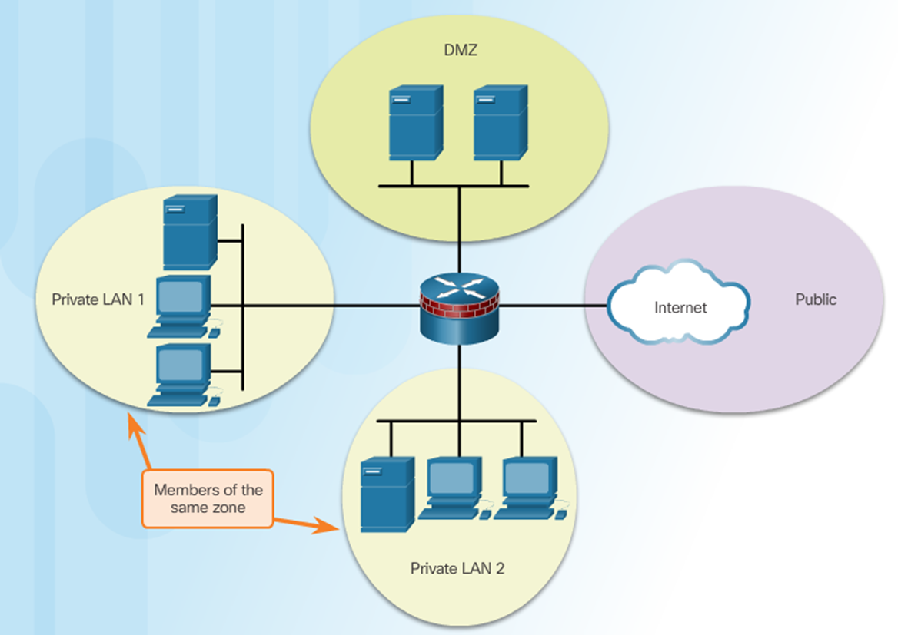
Application Gateways |DMZ

Slide 53
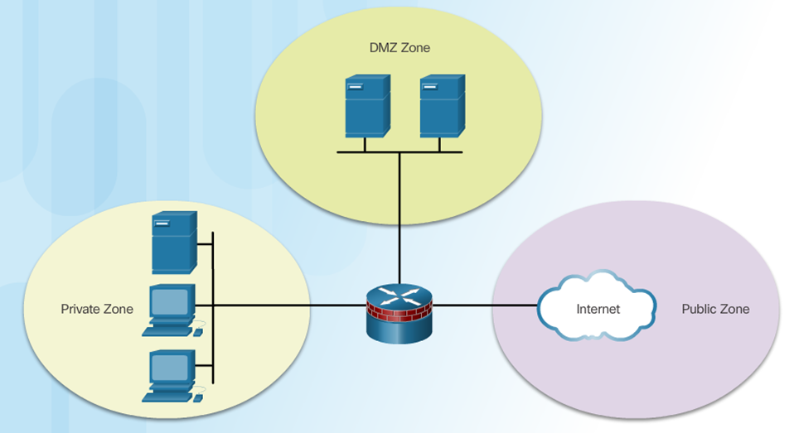
Application Gateways |Zone Based Policy Firewall
Not dependent on ACLs
Router security posture is to block unless explicitly allowed
Policies are easy to read and troubleshoot with C3PL
One policy affects any given traffic, instead of needing multiple ACLs and inspection actions

Slide 54
Application Gateways |ZPF Design
Common designs include:
LAN-to-Internet
Firewalls between public servers
Redundant firewalls
Complex firewalls
Design steps:
Determine the zones
Establish policies between zones
Design the physical infrastructure
Identify subsets within zones and merge traffic requirements

Slide 55
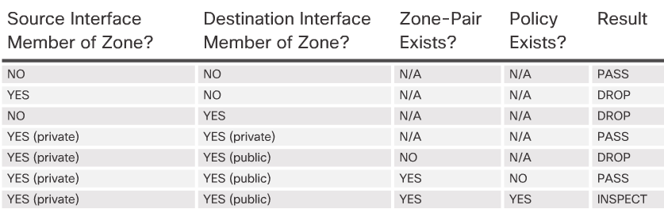
Application Gateways |ZPF Actions
Inspect - Configures Cisco IOS stateful packet inspections.
Drop - Analogous to a deny statement in an ACL. A log option is available to log the rejected packets.
Pass - Analogous to a permit statement in an ACL. The pass action does not track the state of connections or sessions within the traffic.

Slide 56
Application Gateways (Cont.)
One common example of an application-level firewall (or proxy server) is a firewall that blocks all requests for and responses to requests for Web pages and services from the internal computers of an organization, and instead makes all such requests and responses go to intermediate computers (or proxies) in the less protected areas of the organization’s network.
This technique is still widely used to implement electronic commerce functions, although most users of this technology have upgraded to take advantage of the DMZ approach discussed below.

Slide 57
Application Gateways (Cont.)
The primary disadvantage of application-level firewalls is that they are designed for one or a few specific protocols and cannot easily be reconfigured to protect against attacks on other protocols.
Since application firewalls work at the application layer (hence the name), they are typically restricted to a single application (e.g., FTP, Telnet, HTTP, SMTP, and SNMP).
The processing time and resources necessary to read each packet down to the application layer diminishes the ability of these firewalls to handle multiple types of applications.

Slide 58
Circuit Gateways
Circuit Gateways The circuit gateway firewall operates at the transport layer. Again, connections are authorized based on addresses.
Like filtering firewalls, circuit gateway firewalls do not usually look at traffic flowing between one network and another, but they do prevent direct connections between one network and another.
They accomplish this by creating tunnels connecting specific processes or systems on each side of the firewall, and then allowing only authorized traffic, such as a specific type of TCP connection for authorized users, in these tunnels.

Slide 59
MAC Layer Firewalls
MAC Layer Firewalls While not as well known or widely referenced as the firewall approaches above, MAC layer firewalls are designed to operate at the media access control sublayer of the data link layer (Layer 2) of the OSI network model.
This enables these firewalls to consider the specific host computer’s identity, as represented by its MAC or network interface card (NIC) address in its filtering decisions.
Thus, MAC layer firewalls link the addresses of specific host computers to ACL entries that identify the specific types of packets that can be sent to each host, and block all other traffic.

Slide 60
Hybrid Firewalls
Hybrid Firewalls Hybrid firewalls combine the elements of other types of firewalls— that is, the elements of packet filtering and proxy services, or of packet filtering and circuit gateways.
A hybrid firewall system may actually consist of two separate firewall devices; each is a separate firewall system, but they are connected so that they work in tandem.

Slide 61
Hybrid Firewalls (cont.)
For example, a hybrid firewall system might include a packet-filtering firewall that is set up to screen all acceptable requests, then pass the requests to a proxy server, which in turn requests services from a Web server deep inside the organization’s networks.
An added advantage to the hybrid firewall approach is that it enables an organization to make a security improvement without completely replacing its existing firewalls.

Slide 62
Firewalls Categorized by Generation
First generation firewalls are static packet-filtering firewalls—that is, simple networking devices that filter packets according to their headers as the packets travel to and from the organization’s networks.
Second generation firewalls are application-level firewalls or proxy servers—that is, dedicated systems that are separate from the filtering router and that provide intermediate services for requestors.

Slide 63
Firewalls Categorized by Generation (cont.)
Third generation firewalls are stateful inspection firewalls, which, as described previously, monitor network connections between internal and external systems using state tables.
Fourth generation firewalls, which are also known as dynamic packet-filtering firewalls, allow only a particular packet with a particular source, destination, and port address to enter.

Slide 64
Firewalls Categorized by Generation (cont.)
Fifth generation firewalls include the kernel proxy, a specialized form that works under Windows NT Executive, which is the kernel of Windows NT.
This type of firewall evaluates packets at multiple layers of the protocol stack, by checking security in the kernel as data is passed up and down the stack.
Cisco implements this technology in the security kernel of its Centri Firewall.

Slide 65
Virtual Private Networks (VPNs)
Virtual private networks are implementations of cryptographic technology.
A virtual private network (VPN) is a private and secure network connection between systems that uses the data communication capability of an unsecured and public network.
The Virtual Private Network Consortium (VPNC) (www.vpnc. org) defines a VPN as “a private data network that makes use of the public telecommunication infrastructure, maintaining privacy through the use of a tunneling protocol and security procedures.”

Slide 66
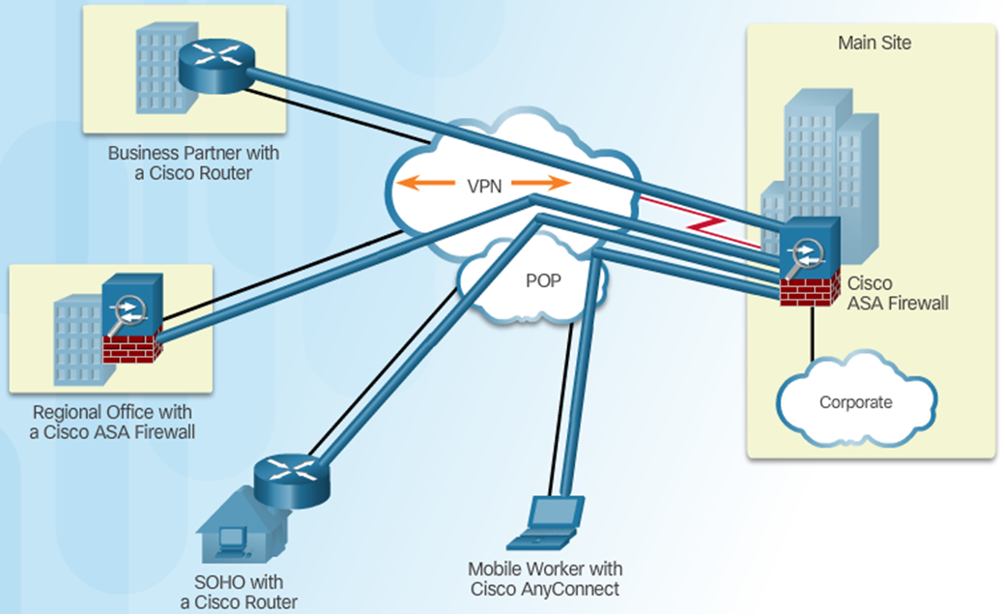
Virtual Private Networks (VPNs) (cont.)
VPN Benefits:
Cost Savings
Security
Scalability
Compatibility

Slide 67
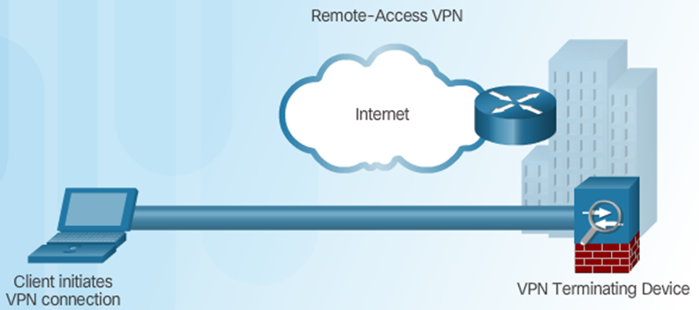
Virtual Private Networks | VPN Types
Remote Access / Users VPN

Slide 68
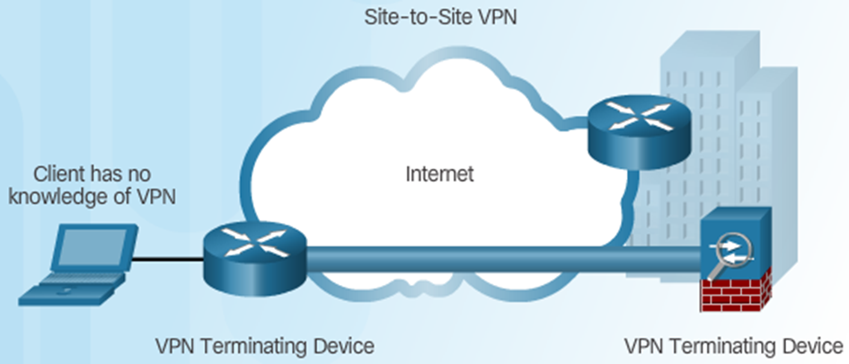
Virtual Private Networks | VPN Types (cont.)
Site-to-Site VPN Access

Slide 69
Virtual Private Networks (VPNs) (cont.)
VPNs are commonly used to securely extend an organization’s internal network connections to remote locations.
The VPNC defines three VPN technologies:
trusted VPNs
secure VPNs
hybrid VPNs.
A trusted VPN, also known as a legacy VPN, uses leased circuits from a service provider and conducts packet switching over these leased circuits.
The organization must trust the service provider, who provides contractual assurance that no one else is allowed to use these circuits and that the circuits are properly maintained and protected—hence the name trusted VPN.

Slide 70
Virtual Private Networks (VPNs) (cont.)
Secure VPNs use security protocols and encrypt traffic transmitted across unsecured public networks like the Internet.
A hybrid VPN combines the two, providing encrypted transmissions (as in secure VPN) over some or all of a trusted VPN network.

Slide 71
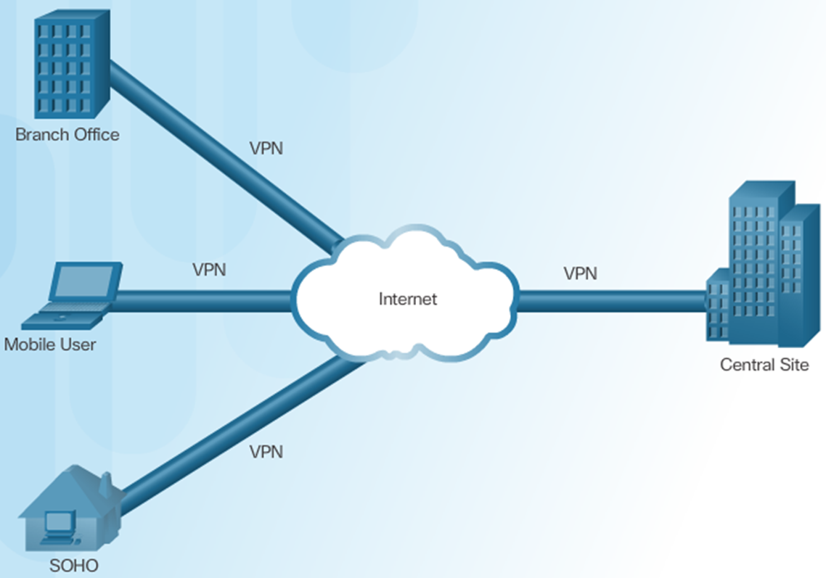
Virtual Private Networks (VPNs) (cont.)

Slide 72
Virtual Private Networks (VPNs) (cont.)
A VPN that proposes to offer a secure and reliable capability while relying on public networks must accomplish the following, regardless of the specific technologies and protocols being used:
Encapsulation of incoming and outgoing data, wherein the native protocol of the client is embedded within the frames of a protocol that can be routed over the public network and be usable by the server network environment.

Slide 73
Virtual Private Networks (VPNs) (cont.)
Encryption of incoming and outgoing data to keep the data contents private while in transit over the public network, but usable by the client and server computers and/or the local networks on both ends of the VPN connection.
Authentication of the remote computer and, perhaps, the remote user as well. Authentication and the subsequent authorization of the user to perform specific actions are predicated on accurate and reliable identification of the remote system and/or user.

Slide 74
Virtual Private Networks (VPNs) (cont.)
In the most common implementation, a VPN allows a user to turn the Internet into a private network. As you know, the Internet is anything but private.
However, an individual or organization can set up tunneling points across the Internet and send encrypted data back and forth, using the IP-packet-within-an-IP-packet method to transmit data safely and securely.
VPNs are simple to set up and maintain and usually require only that the tunneling points be dual-homed—that is, connecting a private network to the Internet or to another outside connection point.

Slide 75
Virtual Private Networks (VPNs) (cont.)
There is VPN support built into most Microsoft server software, including NT and 2000, as well as client support for VPN services built into XP.
While true private network services connections can cost hundreds of thousands of dollars to lease, configure, and maintain, a VPN can cost only a modest amount.
There are a number of ways to implement a VPN. IPSec, the dominant protocol used in VPNs, uses either transport mode or tunnel mode.
IPSec can be used as a stand-alone protocol, or coupled with the Layer Two Tunneling Protocol (L2TP).

Slide 76
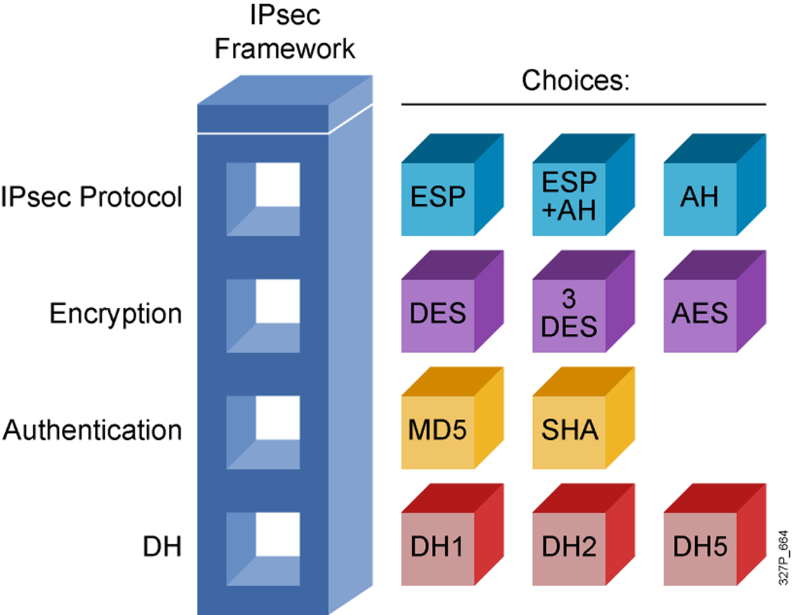
Virtual Private Networks (VPNs) (cont.)

Slide 77
Virtual Private Networks |Transport Mode
In transport mode, the data within an IP packet is encrypted, but the header information is not.
This allows the user to establish a secure link directly with the remote host, encrypting only the data contents of the packet.
The downside to this implementation is that packet eavesdroppers can still identify the destination system.
Once an attacker knows the destination, he or she may be able to compromise one of the end nodes and acquire the packet information from it.

Slide 78
Virtual Private Networks |Transport Mode (cont.)
On the other hand, transport mode eliminates the need for special servers and tunneling software, and allows the end users to transmit traffic from anywhere.
This is especially useful for traveling or telecommuting employees. Figure 3-19 illustrates the transport mode methods of implementing VPNs.

Slide 79
Virtual Private Networks |Transport Mode (cont.)
There are two popular uses for transport mode VPNs.
The first is the end-to-end transport of encrypted data. In this model, two end users can communicate directly, encrypting and decrypting their communications as needed. Each machine acts as the end node VPN server and client.
In the second, a remote access worker or teleworker connects to an office network over the Internet by connecting to a VPN server on the perimeter. This allows the teleworker’s system to work as if it were part of the local area network.

Slide 80
Virtual Private Networks |Tunnel Mode
Tunnel mode establishes two perimeter tunnel servers that encrypt all traffic that will traverse an unsecured network.
In tunnel mode, the entire client packet is encrypted and added as the data portion of a packet addressed from one tunneling server to another. The receiving server decrypts the packet and sends it to the final address.
The primary benefit to this model is that an intercepted packet reveals nothing about the true destination system.

Slide 81
Virtual Private Networks |Tunnel Mode (cont.)
One example of a tunnel mode VPN is provided with Microsoft’s Internet Security and Acceleration (ISA) Server. With ISA Server, an organization can establish a gateway-to-gateway tunnel, encapsulating data within the tunnel.
ISA can use the Point-to-Point Tunneling Protocol (PPTP), L2TP, or IPSec technologies.
The process is straightforward.
First, connect to the Internet through an ISP or direct network connection.
Second, establish the link with the remote VPN server.

Slide 82
Intrusion Detection and Prevention Systems
An intrusion occurs when an attacker attempts to gain entry into or disrupt the normal operations of an information system, almost always with the intent to do harm.
Even when such attacks are self-propagating, as in the case of viruses and distributed denial-of-service attacks, they are almost always instigated by someone whose purpose is to harm an organization.
Often, the differences among intrusion types lie with the attacker—some intruders don’t care which organizations they harm and prefer to remain anonymous, while others crave notoriety.

Slide 83
IDPS (cont.)
Intrusion prevention consists of activities that deter an intrusion.
Some important intrusion prevention activities are writing and implementing good enterprise information security policy, planning and executing effective information security programs, installing and testing technology-based information security countermeasures (such as firewalls and intrusion detection systems), and conducting and measuring the effectiveness of employee training and awareness activities.
Intrusion detection consists of procedures and systems that identify system intrusions.

Slide 84
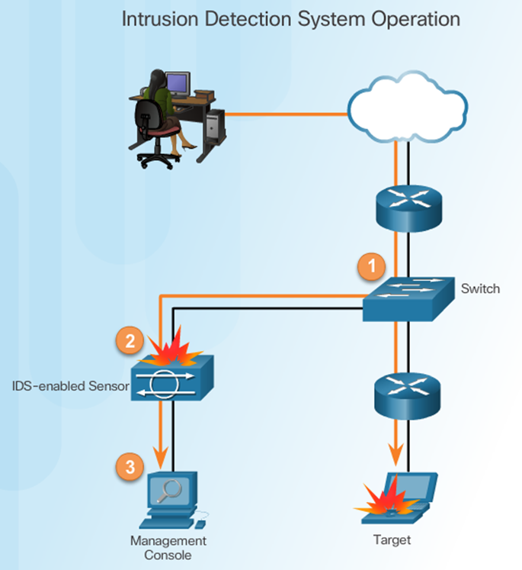
Intrusion Detection System (IDS)
Advantages of an IDS:
Works passively
Requires traffic to be mirrored in order to reach it
Network traffic does not pass through the IDS unless it is mirrored

Slide 85
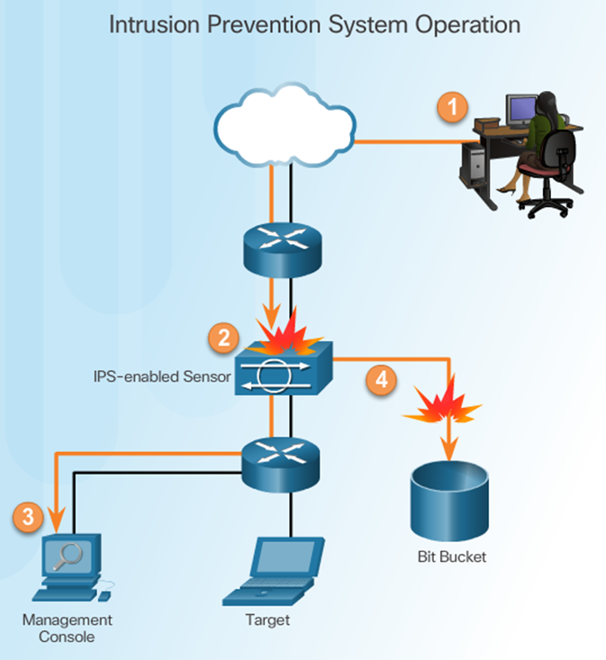
Intrusion Prevention System (IPS)
IPS:
Implemented in an inline mode
Monitors Layer 3 and Layer 4 traffic
Can stop single packet attacks from reaching target
Responds immediately, not allowing any malicious traffic to pass

Slide 86
IDS vs IPS
Advantages IDS:
No impact on network
No network impact if there is a sensor failure
No network impact if there is a sensor overload
Disadvantages IDS:
Response action cannot stop trigger
Correct tuning required for response actions
More vulnerable to network security evasion techniques

Slide 87
IDS vs IPS (Cont.)
Advantages IPS:
Stops trigger packets
Can use stream normalization techniques
Disadvantages IPS:
Sensor issues might affect network traffic
Sensor overloading impacts the network
Some impact on network

Slide 88
IDPS (Cont.)
Intrusion reaction encompasses the actions an organization takes when an intrusion is detected.
These actions seek to limit the loss from an intrusion and return operations to a normal state as rapidly as possible.
Intrusion correction activities finalize the restoration of operations to a normal state and seek to identify the source and method of the intrusion in order to ensure that the same type of attack cannot occur again—thus reinitiating intrusion preventing.

Slide 89
IDPS (Cont.)
Information security intrusion detection systems (IDSs) became commercially available in the late 1990s. An IDS works like a burglar alarm in that it detects a violation (some system activity analogous to an opened or broken window) and activates an alarm.
This alarm can be audible and/or visual (producing noise and lights, respectively), or it can be silent (an e-mail message or pager alert).
With almost all IDSs, system administrators can choose the configuration of the various alerts and the alarm levels associated with each type of alert. Many IDSs enable administrators to configure the systems to notify them directly of trouble via e-mail or pagers.

Slide 90
IDPS (Cont.)
The systems can also be configured—again like a burglar alarm—to notify an external security service organization of a “break-in.” The configurations that enable IDSs to provide customized levels of detection and response are quite complex.
A current extension of IDS technology is the intrusion prevention system (IPS), which can detect an intrusion and also prevent that intrusion from successfully attacking the organization by means of an active response.
Because the two systems often coexist, the combined term intrusion detection and prevention system (IDPS) is generally used to describe current anti-intrusion technologies.

Slide 91
Intrusion Signature
A signature is a set of rules that an IDS and an IPS use to detect typical intrusion activity.
Signatures have three distinct attributes:
Type
Trigger (alarm)
Action

Slide 92
IDPS terminology
In order to understand IDPS operational behavior, you must first become familiar with some IDPS terminology. The following list of IDPS industry standard terms and definitions is taken from a well-known information security company, TruSecure:
Alert or alarm: An indication that a system has just been attacked or is under attack. IDPS alerts and alarms take the form of audible signals, e-mail messages, pager notifications, or pop-up windows.
Evasion: The process by which attackers change the format and/or timing of their activities to avoid being detected by the IDPS.

Slide 93
IDPS terminology (Cont.)
False attack stimulus: An event that triggers an alarm when no actual attack is in progress. Scenarios that test the configuration of IDPSs may use false attack stimuli to determine if the IDPSs can distinguish between these stimuli and real attacks.
False negative: The failure of an IDPS to react to an actual attack event. This is the most grievous failure, since the purpose of an IDPS is to detect and respond to attacks.
False positive: An alert or alarm that occurs in the absence of an actual attack. A false positive can sometimes be produced when an IDPS mistakes normal system activity for an attack. False positives tend to make users insensitive to alarms and thus reduce their reactivity to actual intrusion events.

Slide 94
IDPS terminology (Cont.)
Noise: Alarm events that are accurate and noteworthy but that do not pose significant threats to information security. Unsuccessful attacks are the most common source of IDPS noise, and some of these may in fact be triggered by scanning and enumeration tools deployed by network users without intent to do harm.
Site policy: The rules and configuration guidelines governing the implementation and operation of IDPSs within the organization.

Slide 95
IDPS terminology (Cont.)
Site policy awareness: An IDPS’s ability to dynamically modify its configuration in response to environmental activity. A so-called smart IDPS can adapt its reactions in response to administrator guidance over time and circumstances of the current local environment.
A smart IDPS logs events that fit a specific profile instead of minor events, such as file modification or failed user logins. The smart IDPS knows when it does not need to alert the administrator—for example, when an attack is using a known and documented exploit that the system is protected from.

Slide 96
IDPS terminology (Cont.)
True attack stimulus: An event that triggers alarms and causes an IDPS to react as if a real attack is in progress. The event may be an actual attack, in which an attacker is at work on a system compromise attempt, or it may be a drill, in which security personnel are using hacker tools to conduct tests of a network segment.
Tuning: The process of adjusting an IDPS to maximize its efficiency in detecting true positives, while minimizing both false positives and false negatives.
Confidence value: The measure of an IDPS’s ability to correctly detect and identify certain types of attacks. The confidence value an organization places in the IDPS is based on experience and past performance measurements.

Slide 97
IDPS terminology (Cont.)
Alarm filtering: The process of classifying IDPS alerts so that they can be more effectively managed.
An IDPS administrator can set up alarm filtering by running the system for a while to track what types of false positives it generates and then adjusting the alarm classifications.
For example, the administrator may set the IDPS to discard alarms produced by false attack stimuli or normal network operations. Alarm filters are similar to packet filters in that they can filter items by their source or destination IP addresses, but they can also filter by operating systems, confidence values, alarm type, or alarm severity.

Slide 98
IDPS terminology (Cont.)
Alarm clustering and compaction: A process of grouping almost identical alarms that happen at close to the same time into a single higher-level alarm.
This consolidation reduces the number of alarms generated, thereby reducing administrative overhead, and also identifies a relationship among multiple alarms.
This clustering may be based on combinations of frequency, similarity in attack signature, similarity in attack target, or other criteria that are defined by the system administrators.

Slide 99
Why use an IDPS
According to the NIST documentation on industry best practices, there are several compelling reasons to acquire and use an IDPS:
To prevent problem behaviors by increasing the perceived risk of discovery and punishment for those who would attack or otherwise abuse the system
To detect attacks and other security violations that are not prevented by other security measures
To detect and deal with the preambles to attacks (commonly experienced as network probes and other “doorknob rattling” activities)

Slide 100
Why use an IDPS (Cont.)
3. To document the existing threat to an organization
4. To act as quality control for security design and administration, especially in large and complex enterprises
5. To provide useful information about intrusions that do take place, allowing improved diagnosis, recovery, and correction of causative factors

Slide 101
Why use an IDPS (Cont.)
One of the best reasons to install an IDPS is that they serve as deterrents by increasing the fear of detection among would-be attackers.
If internal and external users know that an organization has an intrusion detection and prevention system, they are less likely to probe or attempt to compromise it, just as criminals are much less likely to break into a house that has an apparent burglar alarm.

Slide 102
The End Thank You
Questions ?

